Slide 1

CARDIOVASCULAR DISEASE PREDICTOR
Ethan Devey
Scott Park-VoKoun
Ioana Platon
Brandon Umana

Slide 2
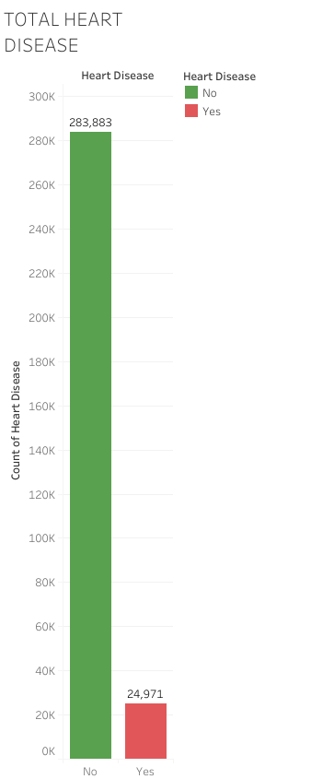
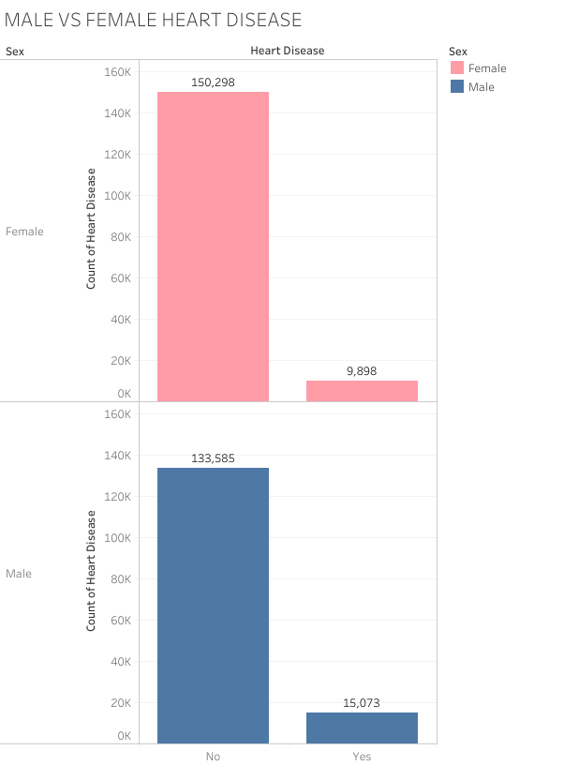
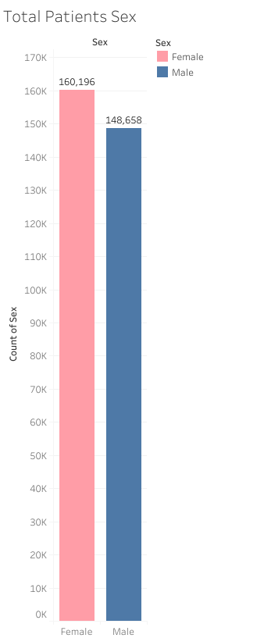
ABOUT THE DATA
Notes:
We wanted to look at trends in cardiovascular disease and make a predictive model that would predict whether or not you would have heart disease based on some dietary factors and biological factors. The data we trained our model with was skewed that over 90% of the data didn’t have CVD, so training a model became difficult and we needed to use a smaller train data set in order to create a model that would be a bit more predictive of yes or no heart disease.

Slide 3
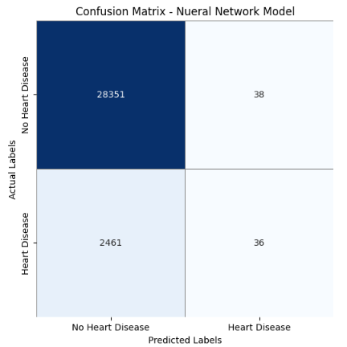
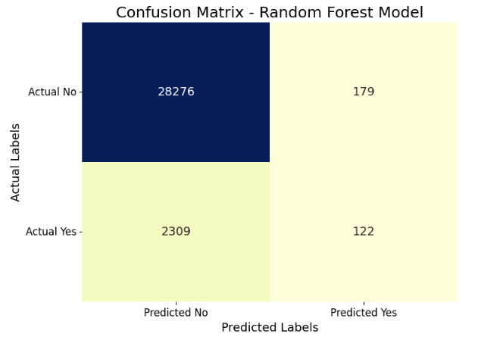
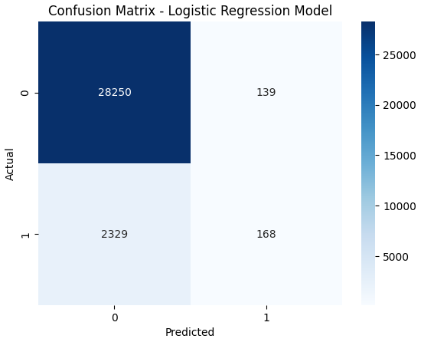
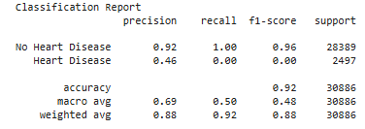
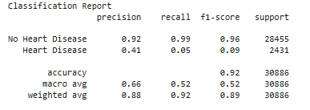
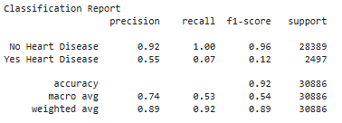
Neural Network Model
Random Forest Model
Logistic Regression Model
Notes:
Because of our skewed data, we ended up playing around with 3 different models to try and improve and optimize our model. Started with Neural Network, then RF, then a Regression model.
In our optimization, we decided to utilize fewer layers (three), various hidden node values, and different random states. Upon completing the neural network model, we got an accuracy score of 91% and a precision of around 40%. Results remained very similar. Upon further inspection of our data, we found that the data we had didn't have enough people in the data set of individuals with heart disease in order for the model to predict heart disease accurately, so we needed to change the amount of data in training and testing. We changed the split ratio of training and testing data and reran everything. With further evaluation of these changes using the confusion matrix and classification reporting, we found that while the overall accuracy score was still in the low 90%s, the precision of detecting heart disease was higher than our initial model but still pretty low at 49%.
We decided to try two additional modules with similar optimizations to see if we could increase the precision score. First, we ran the Random Forest model again with the new split, which garnered very similar results to the first try. The Random Forest model had an accuracy score of 92% for heart disease but a precision score of 41%.
We decided to add a logistic regression model to our optimization. We split and trained the data similarly to previous models. We also created a confusion matrix and classification report. For heart disease, this model's results were 92% accuracy and 55% precision, which were still low but higher than the other two models.
We moved forward with the logistc regression model as our prediction model since these were the highest results. We ran a quick test to see if our model would make a prediction, which it did. We then decided to create an online platform where individuals could input their health data to determine whether they were at risk for CDV.

